Slide 1
Microsoft Cloud Adoption Framework

Slide 2
Microsoft Cloud Adoption Framework
Overview
The Microsoft Cloud Adoption Framework (CAF) for Azure is a collection of documentation, technical guidance, best practices and tools that aligns strategies for business, organizational readiness, and technology to enable desired business outcomes faster and adopt the cloud with confidence

Slide 3






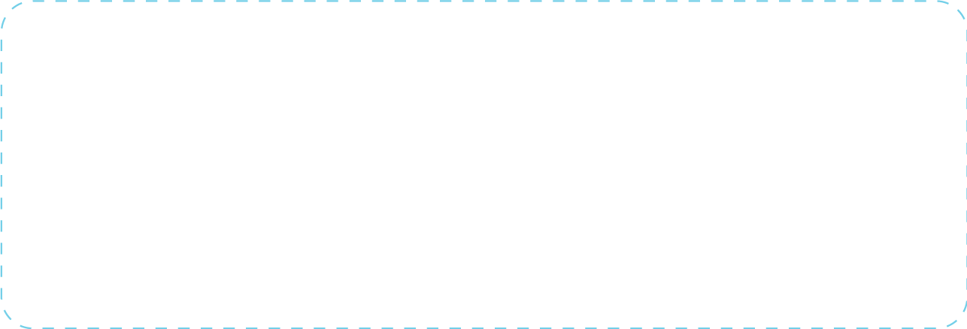






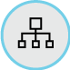
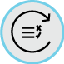
Microsoft Cloud Adoption Framework for Azure
Define Strategy
Understand motivations
Business outcomes
Business justification
Prioritize project
Plan
Digital estate
Initial organization alignment
Skills readiness plan
Cloud adoption plan
Ready
Azure readiness guide
First landing zone
Expand the blueprint
Best practice Validation
Adopt
Migrate
• First workload migration
• Expanded scenarios
• Best practice validation
• Process improvements
Innovate
• Innovation guide
• Expanded scenarios
• Best practice validation
• Process improvements
Operate
Govern
Methodology • Benchmark
Initial best practice • Governance maturity
Manage
Business commitments
Operations baseline • ops maturity
http://azure.com/cloudadoptionframework
Notes:
CAF is our best practices on how to adopt Cloud (aka Azure). We provide resources, tools and documentation for customers looking to transform. The CAF has 6 distinct pillars to it:
Strategy – this is about defining motivations, business outcomes and KPIs and the backlog of work such as which workloads and applications are going to move in the short, medium and long term. (Partner: AppDynamics and Workboard)
Plan – here we help organizations define their teams and the structure of the cloud organization. Customers that understand cloud is a change to the business / operating model are generally more successful in their adoption. Once we have the organization aligned, we also discuss the skills needed for this new operating model. We provide customers with guidance and templates on documenting the Cloud Adoption Plan (you will see this being raised in our Azure Velocity conversations)
Ready – now that we have the Strategy & Plan, we provide guidance and direction on where to build their cloud applications and services. This is call a landing zone. (Tools: 1 of our 3 options for LZ. Partners: New Signature, 10M)
Govern – tightly coupled to the Ready narrative is the important topic of governance in the cloud world. Touching on, Cost, Security, Identity, Resource Management and Consistency in Deployment. (Tools: Benchmark, AzGovViz tool. Partners: OpsCompass)
Adopt –we provide guidance for customers migrating and innovating. In the US we have taken to building patterns we can now surface up to customers so they can incorporate into the Cloud Center of Excellence. This is about repeatable architecture (Tools: Adoption Patterns. Leverage Azure Architecture Center. Well-Architected)
Manage – now that you have your cloud environment and operating rules established what will you do on day 1 to operate and manage. Here we provide guidance on operational baselines as well as how to effectively architect applications and to do reviews of currently deployed systems. (Azure ADO. Partner: OpsCompass. Well-Architected)
Well-Architected – Lastly WA provides guidance on how to best architect applications and a methodology for reviewing apps which are running. (Well-Architected guide, Assessment tool)

Slide 4
Microsoft Cloud Adoption Framework
Governance

Slide 5

How Do I Get Started?
Framework
Frame the conversation to mitigate tangible business risks through consistent governance
1
Benchmark
Assess current state and future state to establish a vision for applying the framework
2
MVP
Establish a Minimally Viable Product (MVP) to serve as a foundation for governance
3
Evolve
Mature with each release to align Cloud Adoption and existing IT functions
4

Slide 6
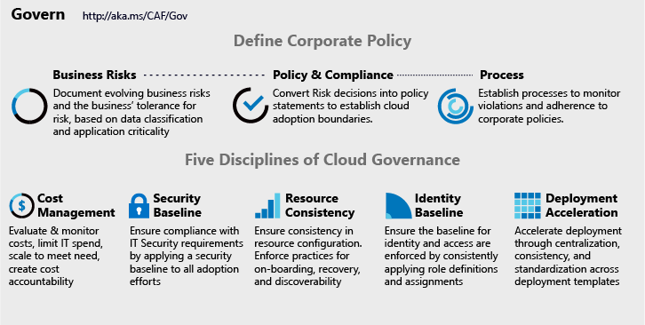
Making Governance Actionable with Native Tools
Azure Monitor
Azure Blueprints
Azure Policy
Azure Cost Management
Azure Advisor
Azure Portal
Azure EA Content Pack
Azure Blueprint
Azure Policy
Resource Grouping & Tagging
Resource Manager Templates
Azure Advisor
Azure DevOps
Azure Site Recovery
Azure Backup
Azure Automation
Azure Blueprints
Azure Policy
Azure Security Center
Azure Sentinel
Subscription Design
Encryption
Hybrid Identity
Azure Networking
Azure Automation
Azure Blueprints
Azure Policy
Azure Monitor
Azure Advisor
Resource Manager Templates
Resource Graph
Management Groups
Azure Blueprints
RBAC
Azure AD
Azure AD B2B
Azure AD B2C
Directory Federation
Directory Replication

Slide 7
Integrating 3rd Party Tools
Monitoring 3rd parties
OpsCompass
Cost Management 3rd parties
HashiCorp Terraform
Deployment 3rd parties
Nagios
HashiCorp Terraform
devops tools like Chef, Puppet, Zabix
Security baseline 3rd parties
Splunk
HashiCorp Vault
Discovery, onboarding, and recovery 3rd parties
ServiceNow
HashiCorp Terraform
3rd party identity providers
HashiCorp Vault
Notes:
What third parties can be used to accomplish similar goals?

Slide 8
How Do I Get Started?
Framework
Frame the conversation to mitigate tangible business risks through consistent governance
1
Benchmark
Assess current state and future state to establish a vision for applying the framework
2
MVP
Establish a Minimally Viable Product (MVP) to serve as a foundation for governance
3
Evolve
Mature with each release to align Cloud Adoption and existing IT functions
4

Slide 9
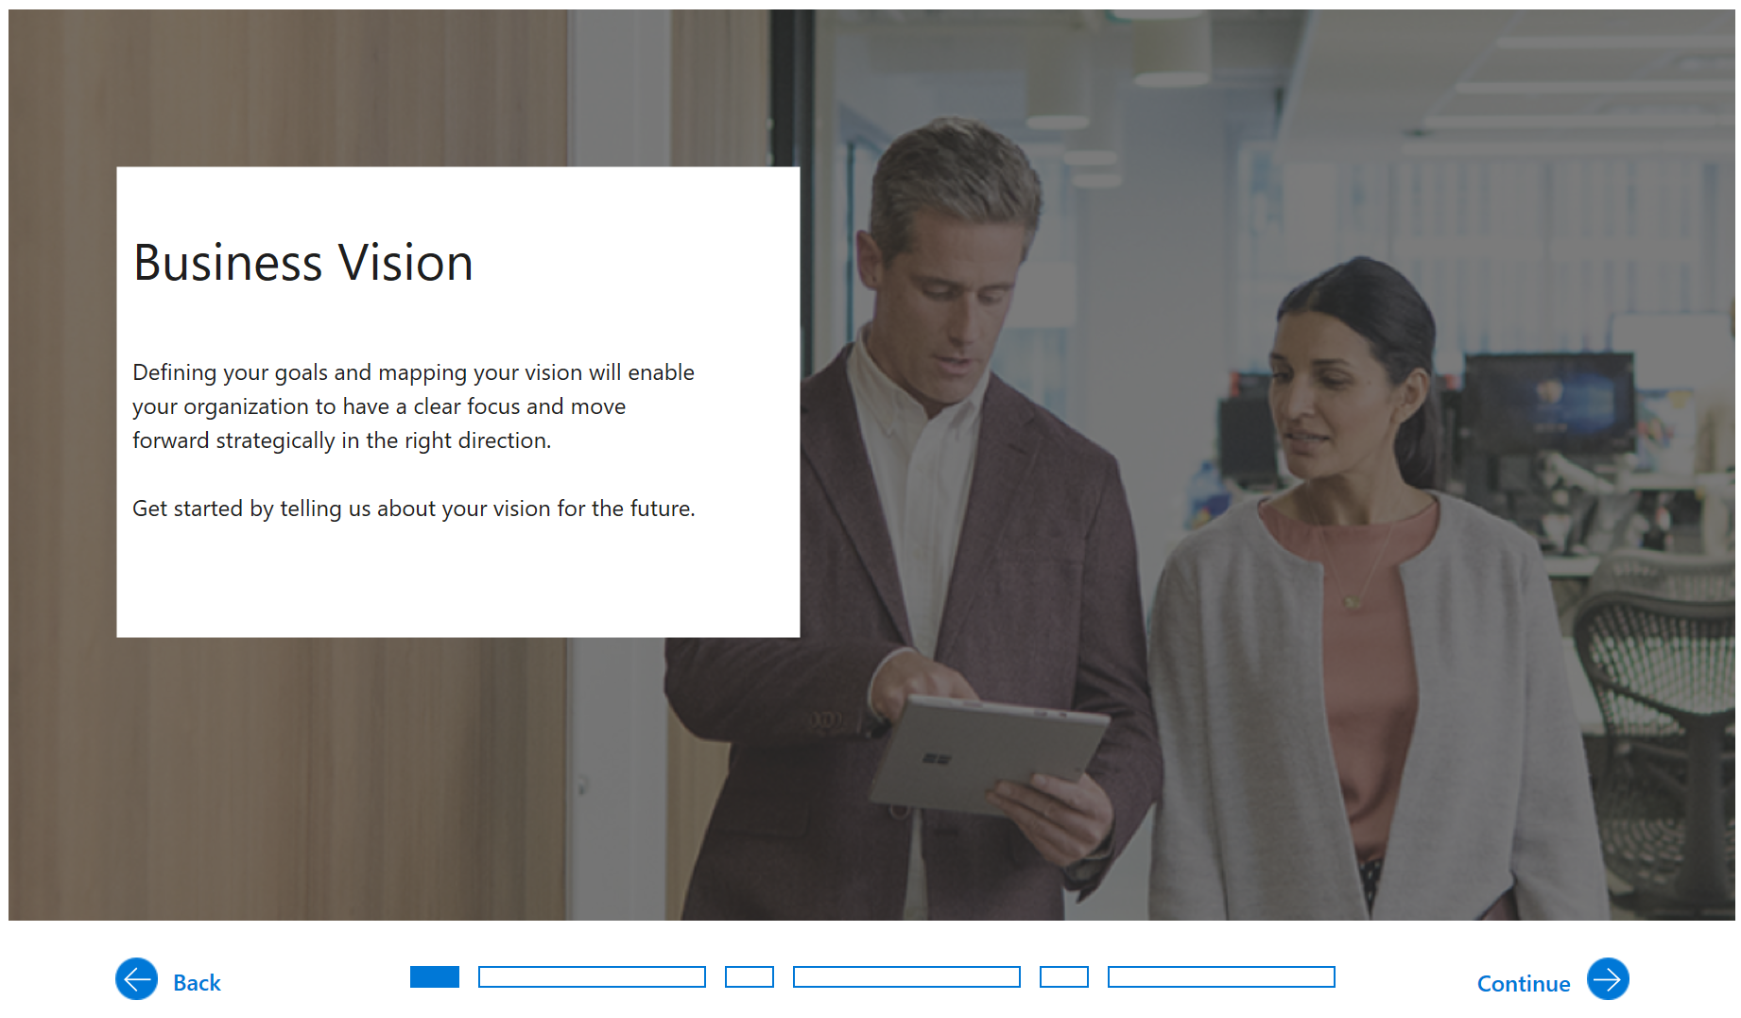
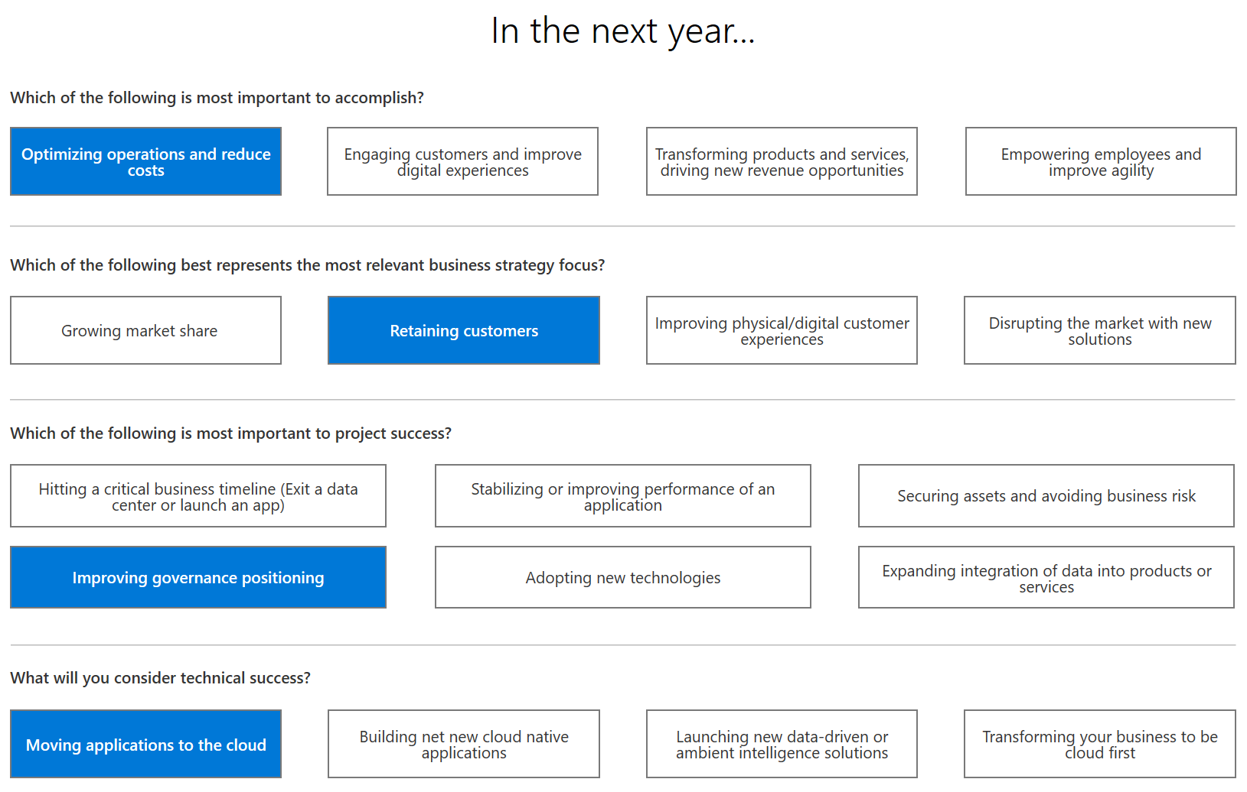
Understand the Business Vision Driving Cloud Adoption

Slide 10
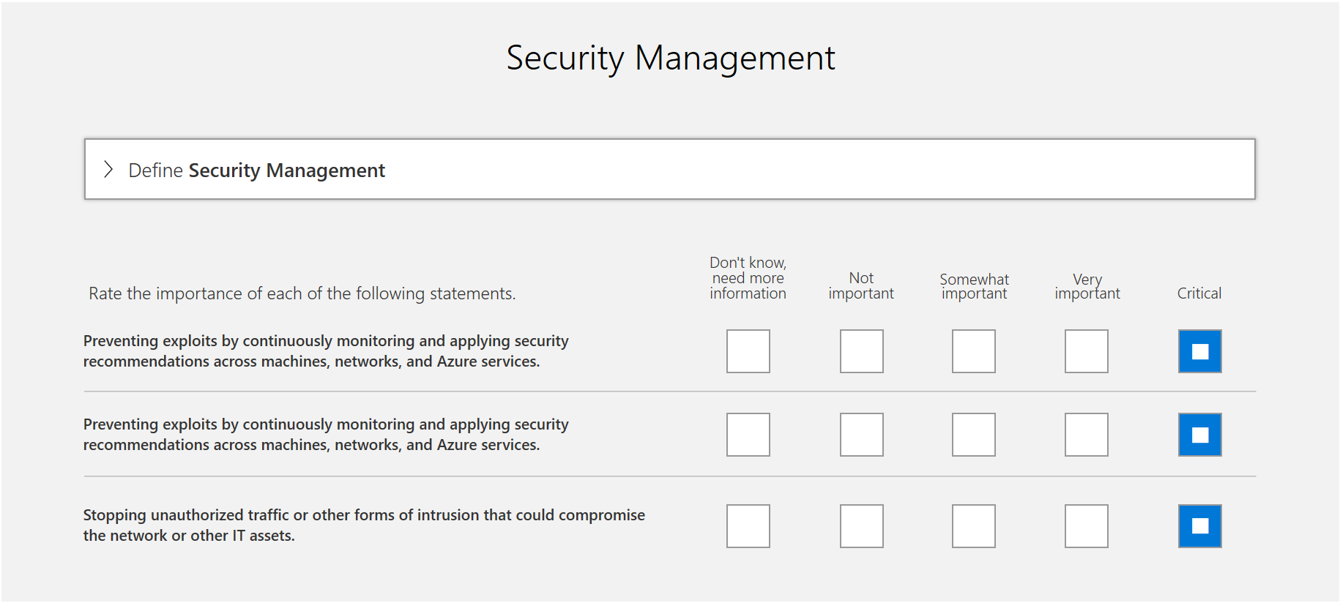
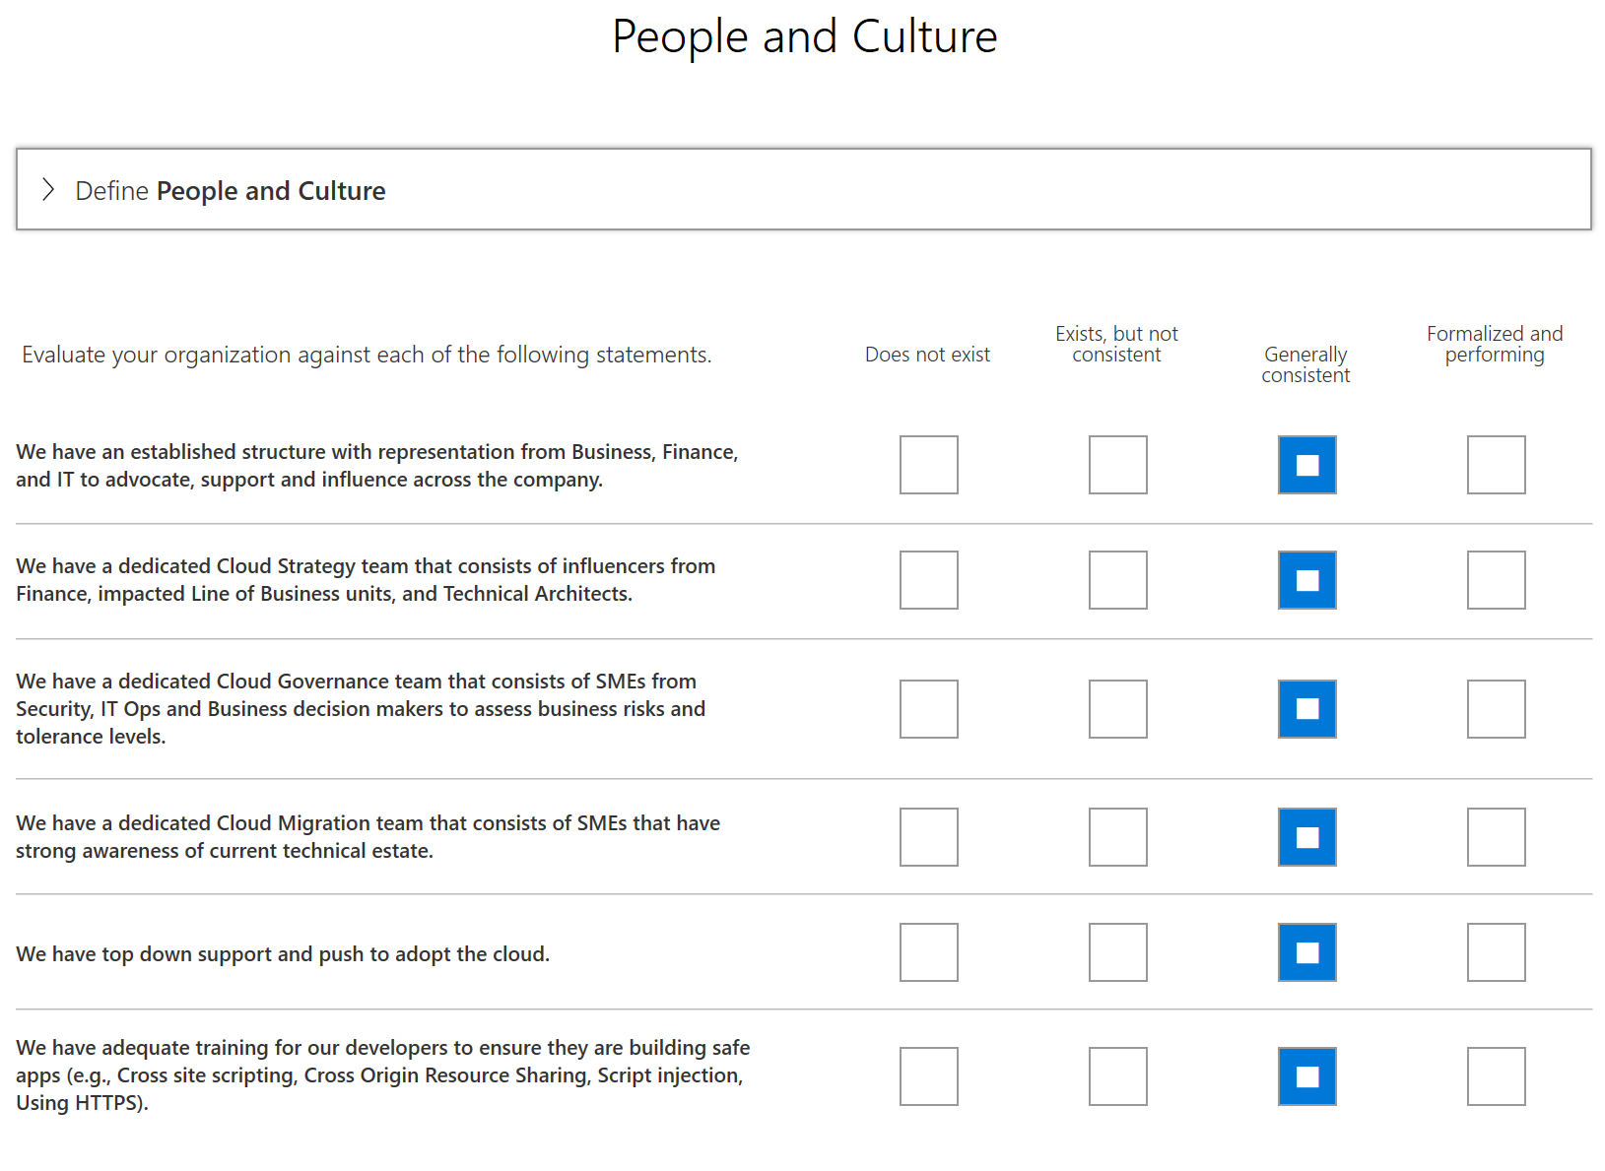
Priorities and Current State

Slide 11
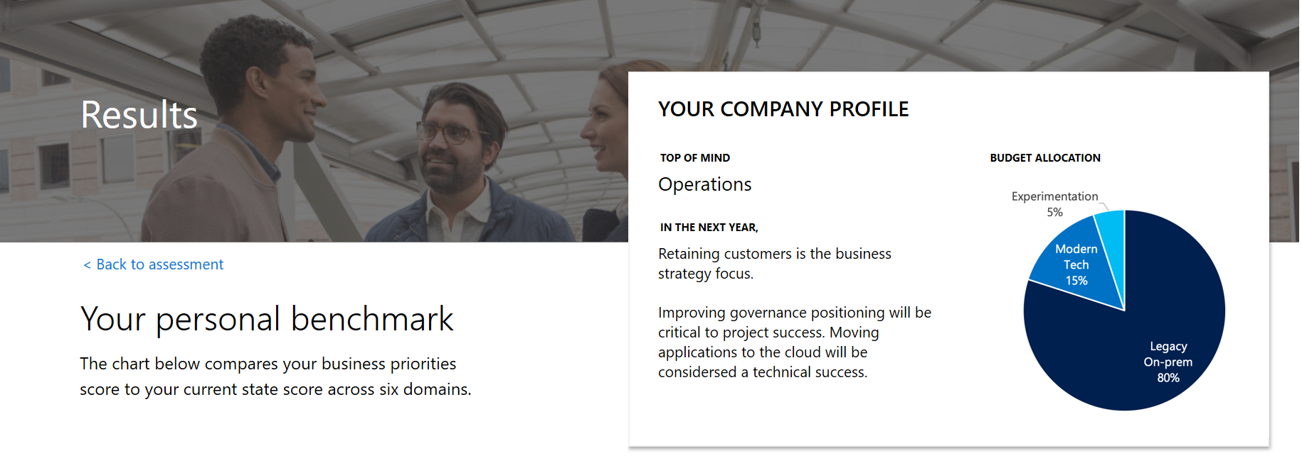
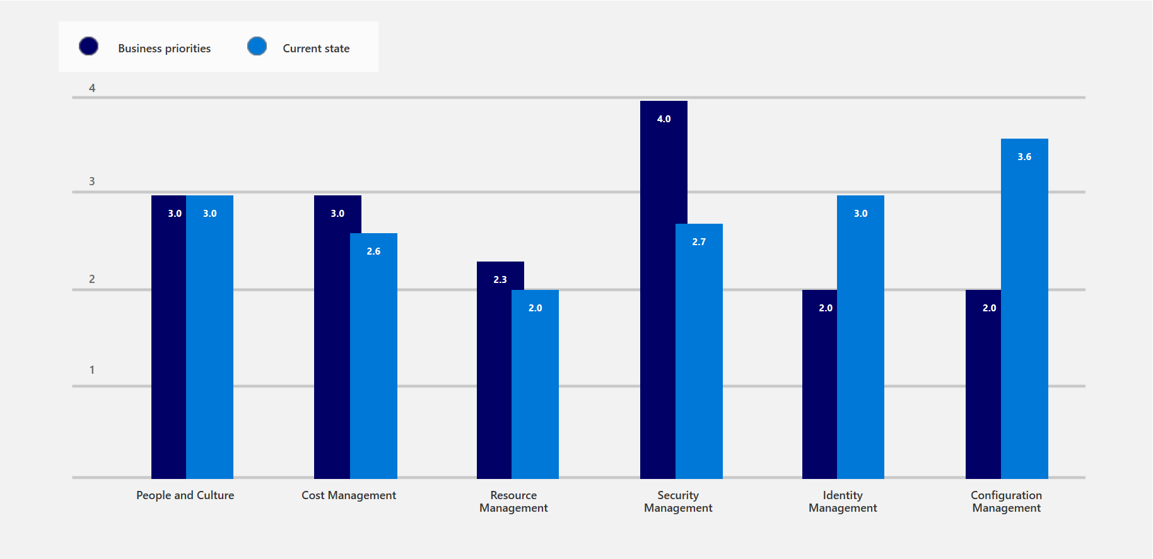
Evaluating Current State
Security management appears to be an important area of focus for this customer.

Slide 12
How Do I Get Started?
Framework
Frame the conversation to mitigate tangible business risks through consistent governance
1
Benchmark
Assess current state and future state to establish a vision for applying the framework
2
MVP
Establish a Minimally Viable Product (MVP) to serve as a foundation for governance
3
Evolve
Mature with each release to align Cloud Adoption and existing IT functions
4

Slide 13
Next Steps
1. Assess
Use the free CAF Governance Assessment to aid in identifying current state, future state, and gaps.
Assessment Link
2. MVP
Select and deploy an appropriate Governance MVP.
CAF Governance Journeys and MVP Design
3. Evolve
Execute your first Customer Journey with the support of Microsoft.
Consult with your account team to learn more.

Slide 14

How Do I Get Started?
Motivations
Understand motivations and business objectives which will drive migration decisions
1
Prerequisites
Validate prerequisites aligned to Motivations and Migration Phase Investments
2
n^{th} Workload
Learn the tools and approaches migrating a 1st workload using the Azure Migration Guide
3
Mature Processes
Mature an iterative migration process to align with the needs of your org, existing constraints and candidate workloads
4

Slide 15
Cloud Adoption Motivations
Why is the company adopting the cloud?
More than one motivation is common in most cloud adoption efforts
Critical Business Events
Data center exit
Mergers, acquisition or divestiture
Reductions in capital expenses
End of support for mission critical technologies
Regulatory compliance, data sovereignty requirements
Reduce disruptions and improve IT stability
Migrate Motivations
Cost Savings
Reduction in vendor or technical complexity
Optimization of internal operations
Increase business agility
Prepare for new technical capabilities
Scale to meet market demands
Scale to meet geographic demands
Innovation Motivations
Prepare for new technical capabilities
Build new technical capabilities
Scale to meet market demands
Scale to meet geographic demands
Improve customer experiences / engagements
Transform products or services
Disrupt the market with new products or services

Slide 16
How Do I Get Started?
Motivations
Understand motivations and business objectives which will drive migration decisions
1
Prerequisites
Validate prerequisites aligned to Motivations and Migration Phase Investments
2
n^{th} Workload
Learn the tools and approaches migrating a 1st workload using the Azure Migration Guide
3
Mature Processes
Mature an iterative migration process to align with the needs of your org, existing constraints and candidate workloads
4

Slide 17

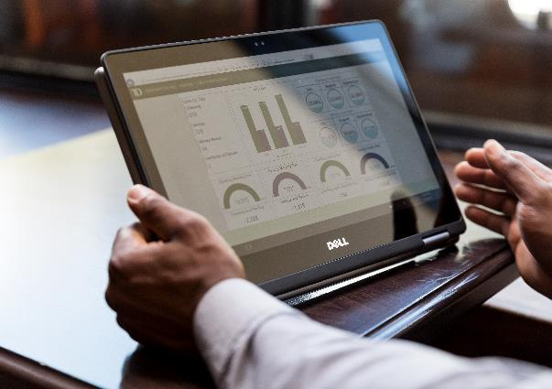

Plan Prerequisites
First workload
Demonstrate a growth mindset by choosing a small, low impact, self-contained first workload for the Cloud Adoption Team to migrate & learn. See next section for guidance on execution.
Business justification
Align the right level of business justification using calculators and Azure Migrate, digital estate rationalization, and/or a migration business case.
Build a migration plan
Align business and technical strategies to rationalization the digital estate and create an initial migration backlog.
Notes:
Before beginning a migration, the above should be completed or in process of being completed

Slide 18


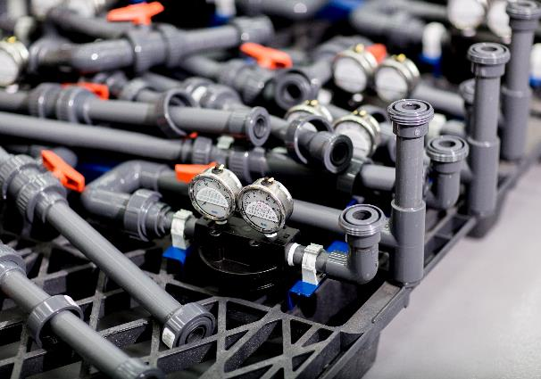
Ready Prerequisites
Business readiness
Create initial org alignment with a Cloud Strategy Team to represent business needs and market changes in the migration backlog
Skill & support readiness
Create a skills readiness plan for staff (IT and Business Staff), identify execution gaps, align key partners, choose support and services options
Environment Readiness
Establish a Landing Zone in the cloud. This target should be readied to handle the workloads and assets being migrated to the cloud
Notes:
Before beginning a migration, the above should be completed or in process of being completed

Slide 19
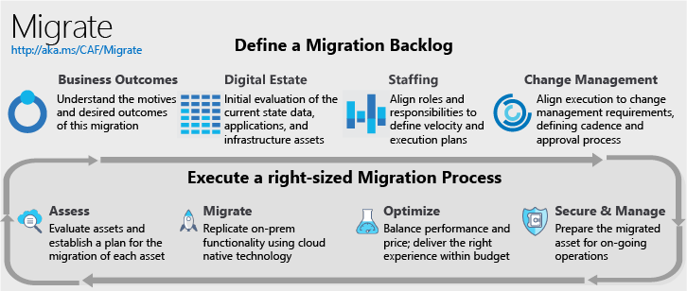
Migration Methodology Prioritize investments of time and energy based on migration objectives
Migration Implementation
Notes:
Note: The three phase names (denoted with an asterix *) are to be tested with customers & refined.
The Asset phase of migration is where most of the technical work happens, moving assets to the cloud.
If the customer has workload objective(s) for this migration, they will need to invest in a bit more structure and follow the workload phase guidance
If the customer has portfolio objectives(s) for this migration, they will also need to invest in the portfolio phase structure.
Every customer will execute the asset phase of migration. Every customer should invest in the full portfolio phase, if they wish to produce business returns from the migration effort.
In a factory model, Asset phase is like the factory floor where the parts are assembled & shipped.
If the customer has

Slide 20
How Do I Get Started?
Motivations
Understand motivations and business objectives which will drive migration decisions
1
Prerequisites
Validate prerequisites aligned to Motivations and Migration Phase Investments
2
n^{th} Workload
Learn the tools and approaches migrating a workload using the Azure Migration Guide
3
Mature Processes
Mature an iterative migration process to align with the needs of your org, existing constraints and candidate workloads
4

Slide 21

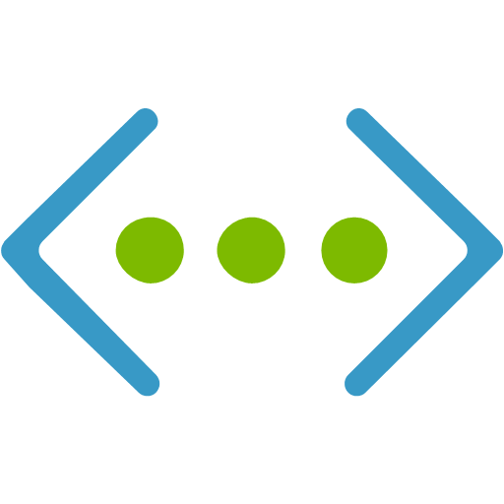



Azure Readiness Guide (Create the Landing Zone)
Naming Standards
Resource Organization
Identity and Access
Compute
Network
Storage
Manage
Governance
Configuring virtual machines for availability, scale and performance
Designing the network for current and future connectivity requirements
Planning for performance, durability, scalability and archival
Planning for production operations for monitoring and disaster recovery
Control access to resources, what can be used, setup cost management and chargeback
Build a solid foundation using best practices and prescriptive guidance prior to starting migration efforts
Azure Readiness Guide: https://docs.microsoft.com/en-us/azure/cloud-adoption-framework/ready/azure-setup-guide/index

Slide 22

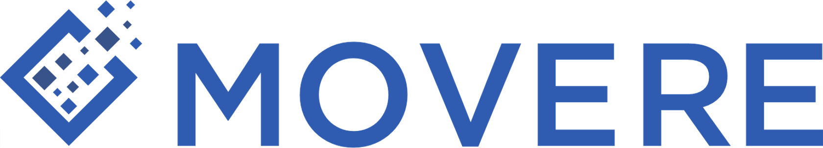
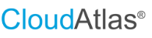
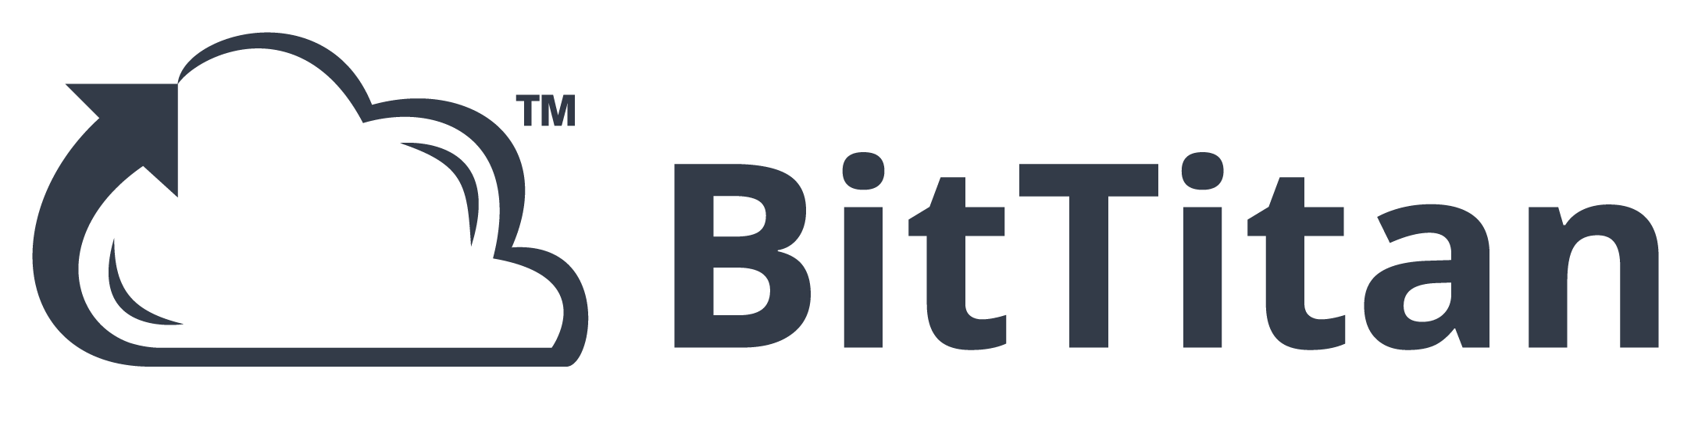
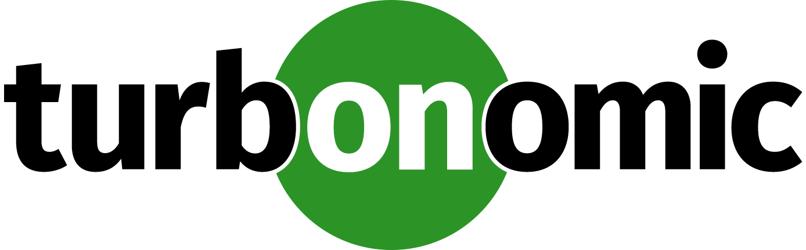


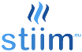
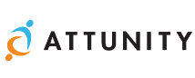

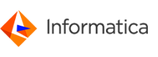
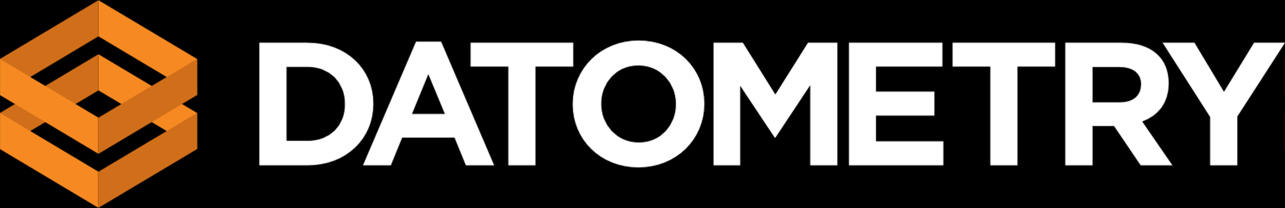


Azure Migration Guide
Assess
Migrate
Optimize
Secure & Manage
Azure Migrate
Azure Site Recovery (ASR)
Azure Cost Management
Azure Advisor
Azure Security & Management
(e.g., Blueprints, Security Center, Backup, Monitor)
Data Migration Assistant (DMA)
Azure Database Migration Service
SQL Server Migration Assistant (SSMA)
Azure Data Box
ISV solutions (as needed)
Notes:
Our goal is to enable successful Azure migration, regardless of what tool was used.
We have a great set of first party Azure tools that are built into the Azure portal and free to get started.
But we also have a great set of third party tools to meet all your requirements. For example: Cloudamize, Movere, Turbonomic, TSO Logic can discover a broader set of environments than Azure Migrate does today. Similarly, tools like Zerto and Cloud Endure can migrate a broader set of OS’es to Azure as compared to Azure Site Recovery.
We’re also working closely with the ecosystem to build out a unified experience across Azure and 3rd party tools.

Slide 23
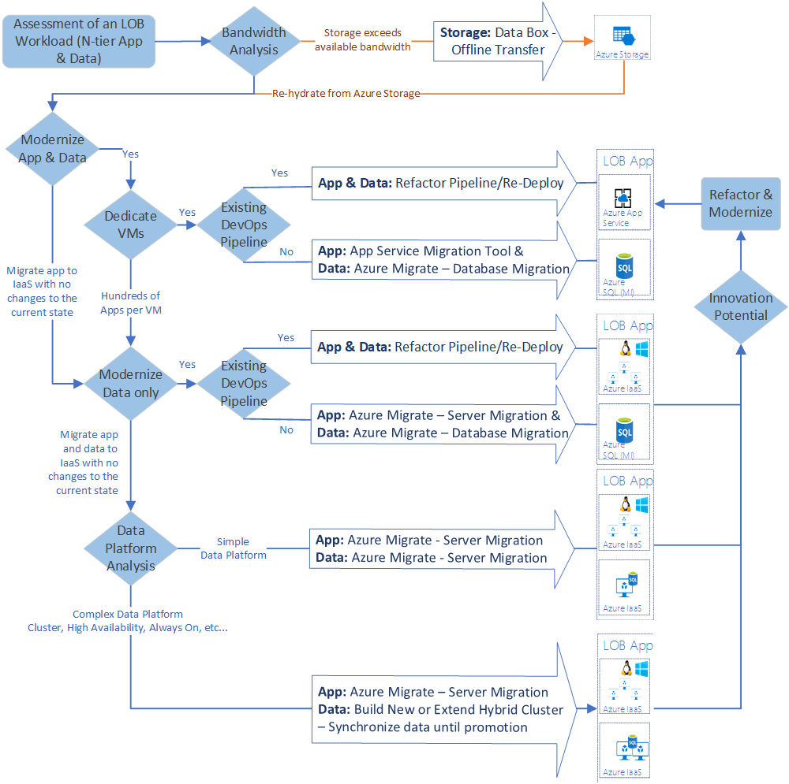
Migration Tooling Options
* Example *
Migration is more than a shift & lift rehost to IaaS using tools like Azure Site Recovery.
Modernize some assets during migration with PaaS focused solutions like Database Migration Service
Over time, refactor and modernize any workloads that represent innovation potential

Slide 24
How Do I Get Started?
Motivations
Understand motivations and business objectives which will drive migration decisions
1
Prerequisites
Validate prerequisites aligned to Motivations and Migration Phase Investments
2
n^{th} Workload
Learn the tools and approaches migrating a 1st workload using the Azure Migration Guide
3
Mature Processes
Mature an iterative migration process to align with the needs of your org, existing constraints and candidate workloads
4

Slide 25
Mature Migration Processes (End state & actions)
Aggregate data to execute a workload, constraint, & dependency analysis
Align sub-processes to fit the teams, roles, & responsibilities
Ensure every member of the team can use business outcomes as a test for decisions
Align sub-processes to fit change management and change approval processes across IT and business unit
Mature Assessment:
Quickly evaluate cloud compatibility
Align appropriate cloud architecture
Match the appropriate migration tool
Mature Migration:
Standardized process
Allow multiple migration tools
Enable limited workload modernization during migration
Mature Optimization:
Data-driven testing
Balance of performance and cost
Low impact promotion process
Consistent on-boarding
Mature Operations:
Integration with ops, governance, and security
High workload reliability
Well-governed environment.

Slide 26
Example of Resilient Architecture Options
Cloud Infrastructure Architect | Cloud Infrastructure Ops
Premium Storage
Availability Sets
Availability Zones
Azure Site Recovery / Region Pairs
Region 2
Region 1
Data center 1
Single VM
Data center
Zone 1
Zone 1
Infrastructure
(applications and data)
Rack 1
Rack 2
Data center 2
Zone 2
Zone 3
Zone 2
Zone 3
Hardware failure
Rack level failure
Datacenter outage
Natural Disaster
Accidental data loss
Data corruption
Ransomware
Data
(stateful)
Restore to a certain point in time with healthier data
Backup
Learn more about org roles, best practices, and Azure capabilities at the 4/19 briefing: Achieving Resilience in the Cloud
Notes:
Just in 2018, 28% of customers have experienced data loss and 40% have experienced an unplanned outage. Just 2% of organizations recovered from their latest incident in under an hour. Azure’s overall availability has been trending up constantly and is now at over 99.999% reliability across the fleet. Microsoft’s cloud technology provides innovative features such as memory-preserving host updates and live migration. But more importantly, Azure provides a comprehensive set of built-in resilient services to recover from hardware failures, natural disasters and data loss. As a result, we see more customers enable their mission-critical workloads on Azure.
So we have seen how Resilience is not about avoiding any failure but bouncing back from one. Let’s look at some typical failures that may lead to a downtime for your application –
This trapezium shows the degree of impact that a failure can potentially cause. So while, a power or a network outage may impact a datacenter of a multiple data centers in a zone; something more catastrophic like a flood or earthquake can take down the entire region. All these failures primarily impact your infrastructure (which comprises of both applications and the data).
There’s one thing that is common across though, no matter what your deployment is (you can be running the entire set up in a single region vs spread across zones), you will most likely have data; data which is stateful; data which you would need to go back to.
The failures impacting this data look like these. And to draw a parallel, these too in some sense have varying degree of impact of these failures on the data; while accidental deletion may lead to losing a file or folder; a rogue admin can wipe off not only your data but also your backups.
Thus, we need to build resilience against all these failure and the azure services can help us achieve just that.
Opt for Premium storage that allows for 99.5% availability in case of a single VM deployment.
Up your Resilience game with High Availability structures; deploy your architecture in Availability sets or AZs to get SLA up to 99.99%. HA should be preferred for your mission critical apps which have very stringent RPO and RTO requirements (almost real time).
Go one step head to further isolate your VMs by making used of paired regions in azure. The recently previewed feature for storage account failover when configured for GRS also is a subset of this solution.
But none of them still covers you for data failures; and that’s because all of these deployments are almost constantly syncing data across; so if any data corruption happens and I need to go back in time to say a couple of days, I need to have backed-up that version. Hence, we have Backup.

Slide 27
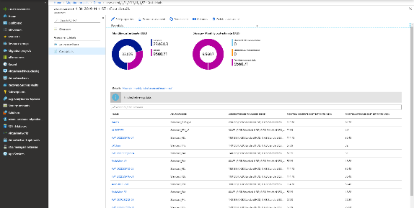
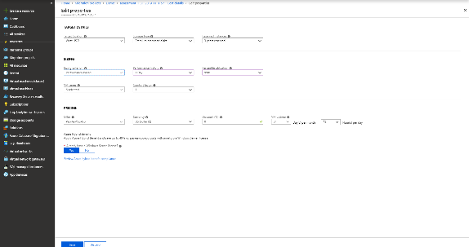

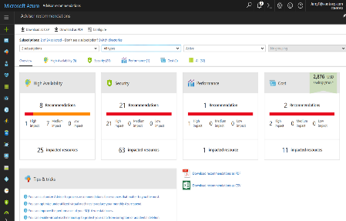
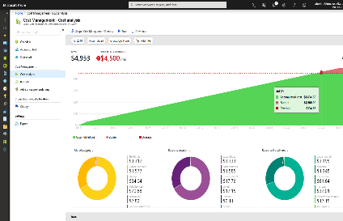
Continuously optimize resources during and after migration
As you move
Right-size Azure resources based on assessment guidance
Use Azure Hybrid Benefit and Azure Reserved Instances to save money
After you move
Unified experience to optimize cloud spends: Azure Cost Management
Azure Advisor: Built-in best practice recommendations
(e.g., turn off idle VMs)
Balance optimization and performance decisions with
Azure Monitor
Modernize for longer term value
Notes:
Let us now transition to the Optimize phase in the Azure migration journey.
Many customers look to the cloud to gain operational efficiencies and cost savings. With Azure Cost Management , customers can now manage their cloud spend in a unified experience, and leverage built-in best practice recommendations (e.g., turning off idle VMs) to drive operational efficiency. They can apply Azure Hybrid Benefit and Azure Reserved Instances during or after migration for big savings.
Link to blog

Slide 28
Summary
Governance:
Review the Governance framework: http://aka.ms/caf/gov
Run through the Governance Benchmark Tool with your Microsoft rep or Partner: aka.ms/caf/gov/assess
Build MVP on outcomes of the benchmark
Migrate:
Review the Migration framework: http://aka.ms/caf/migrate
Assess your workloads to build a Migration backlog, Azure Migrate or 3P solution
Plan your Migrations

Slide 29
Thank You

